Slide 1
Federal Income Taxation Compensation
Prof. Colon
Spring 2025

Slide 2
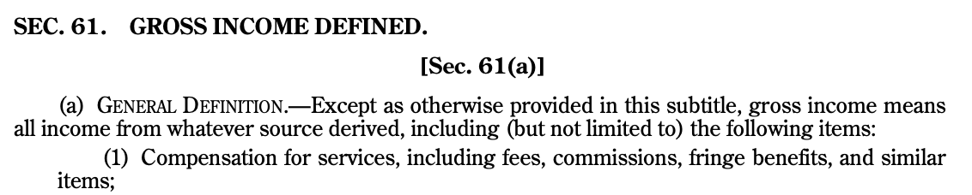
Section 61(a)(1)

Slide 3
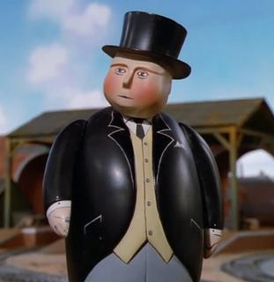
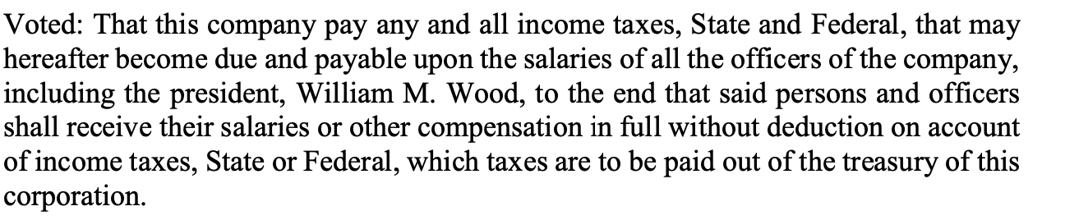
Old Colony Trust Co. v. CIR (279 U.S. 716 (1929)
American Woolen Co.
William Wood, President
Salary
1918: 1MM
1919: 550K
Taxes Paid
1918: 680K
1919: 351K

Slide 4
Reg. 1.61-2(a)(1), (d)(1)
(a) In general.—(1) Wages, salaries, commissions paid salesmen, compensation for services on the basis of a percentage of profits, commissions on insurance premiums, tips, bonuses (including Christmas bonuses), termination or severance pay, rewards, jury fees, marriage fees and other contributions received by a clergyman for services, pay of persons in the military or naval forces of the United States, retired pay of employees, pensions, and retirement allowances are income to the recipients unless excluded by law.
(d) Compensation paid other than in cash.—(1) In general.—Except as otherwise provided in paragraph (d)(6)(i) of this section (relating to certain property transferred after June 30, 1969), if services are paid for in property, the fair market value of the property taken in payment must be included in income as compensation. If services are paid for in exchange for other services, the fair market value of such other services taken in payment must be included in income as compensation. If the services are rendered at a stipulated price, such price will be presumed to be the fair market value of the compensation received in the absence of evidence to the contrary.

Slide 5




Rev. Rul. 79-24
Situation 1
I’ll provide legal services
I’ll paint your house
Situation 2
I’ll rent my apartment to you
I’ll give you a painting

Slide 6
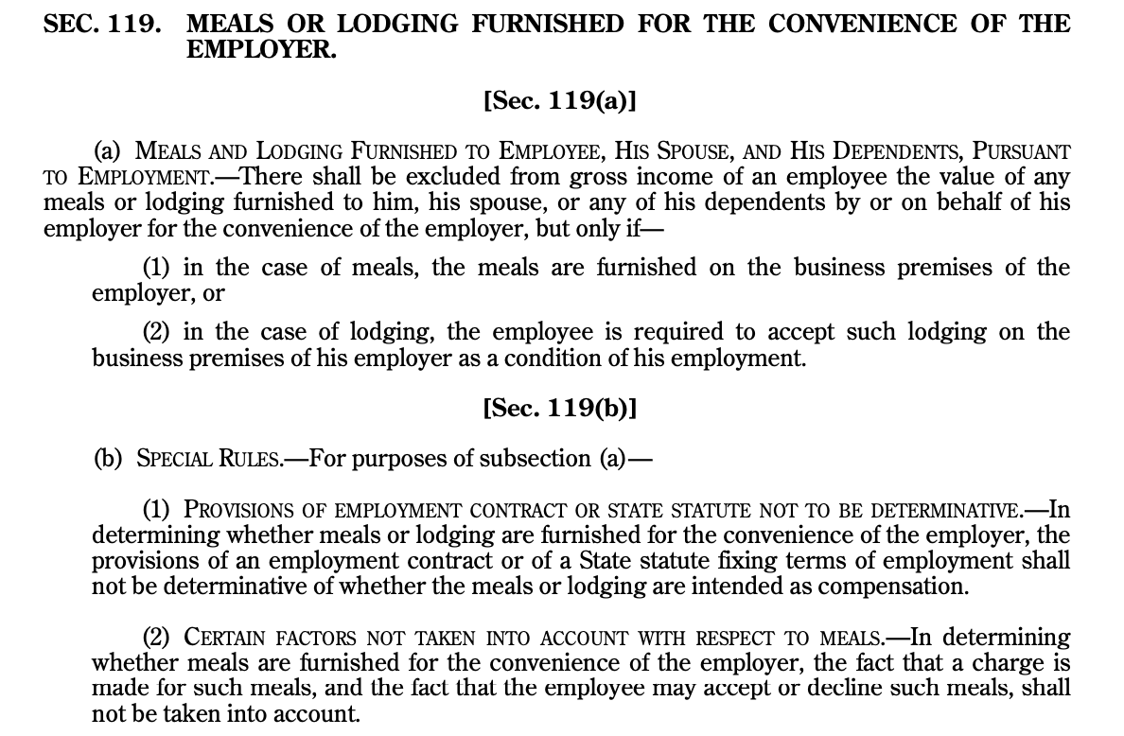
Section 119(a) and (b); and Reg 1.119-1(a)(2)
Substantial Noncompensatory Business Reason for Furnishing Meals (Reg. 1.119-1(a)(2)(ii))
Have employee available for emergency call during meal period
E/ee restricted to short meal period (30-40 minutes) and couldn’t be expected to eat elsewhere
E/ee couldn’t otherwise secure proper meals w/in reasonable meal period.
Meal furnished to restaurant employee (during, immediately before or after)
Meals furnished to substantially all e/ees is noncompensatory, meals furnished to other is noncompensatory
Meals furnished to e/ee to promote morale or goodwill regarded as compensatory

Slide 7
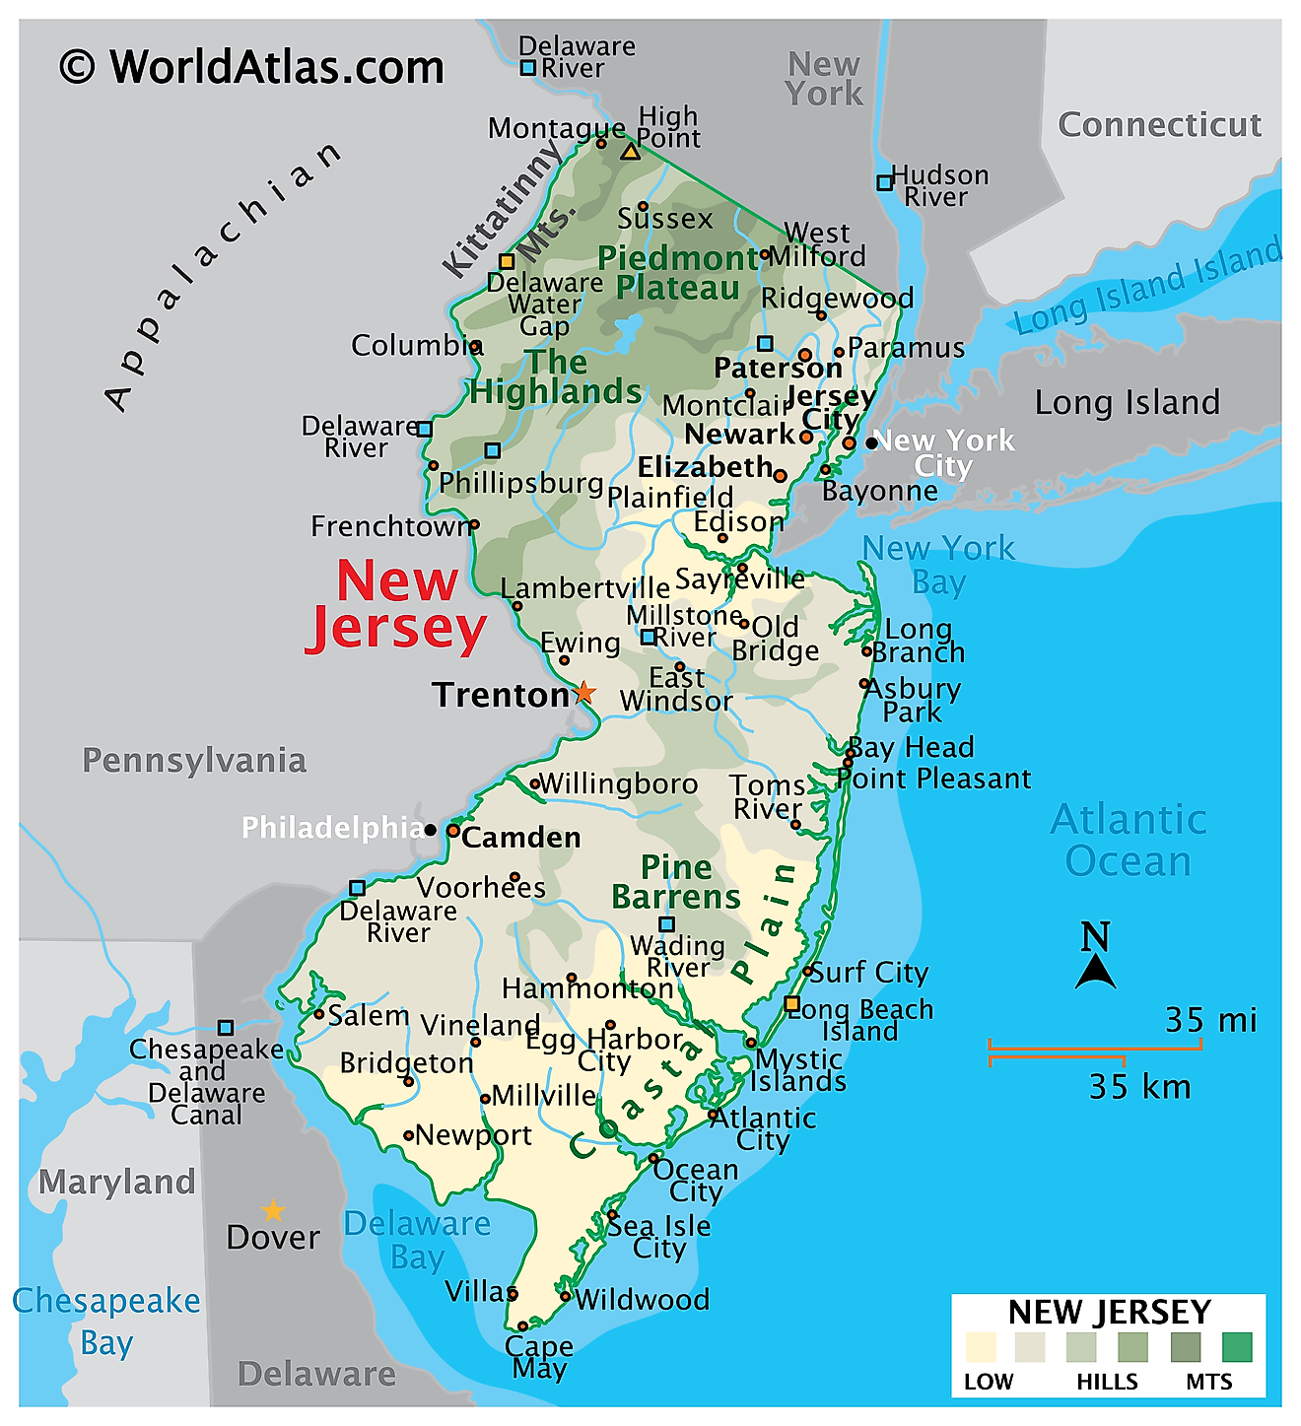
CIR v. Kowalski, 434 U.S. 77 (1977)
NJ state trooper received $1.7K in cash, which was designated as allowance for meals.
Troopers remain on call during mid-shift break
Troopers not restricted in where they may eat
Troopers not required to spend meal allowances
Trooper not required to account for how the money is spent

Slide 8
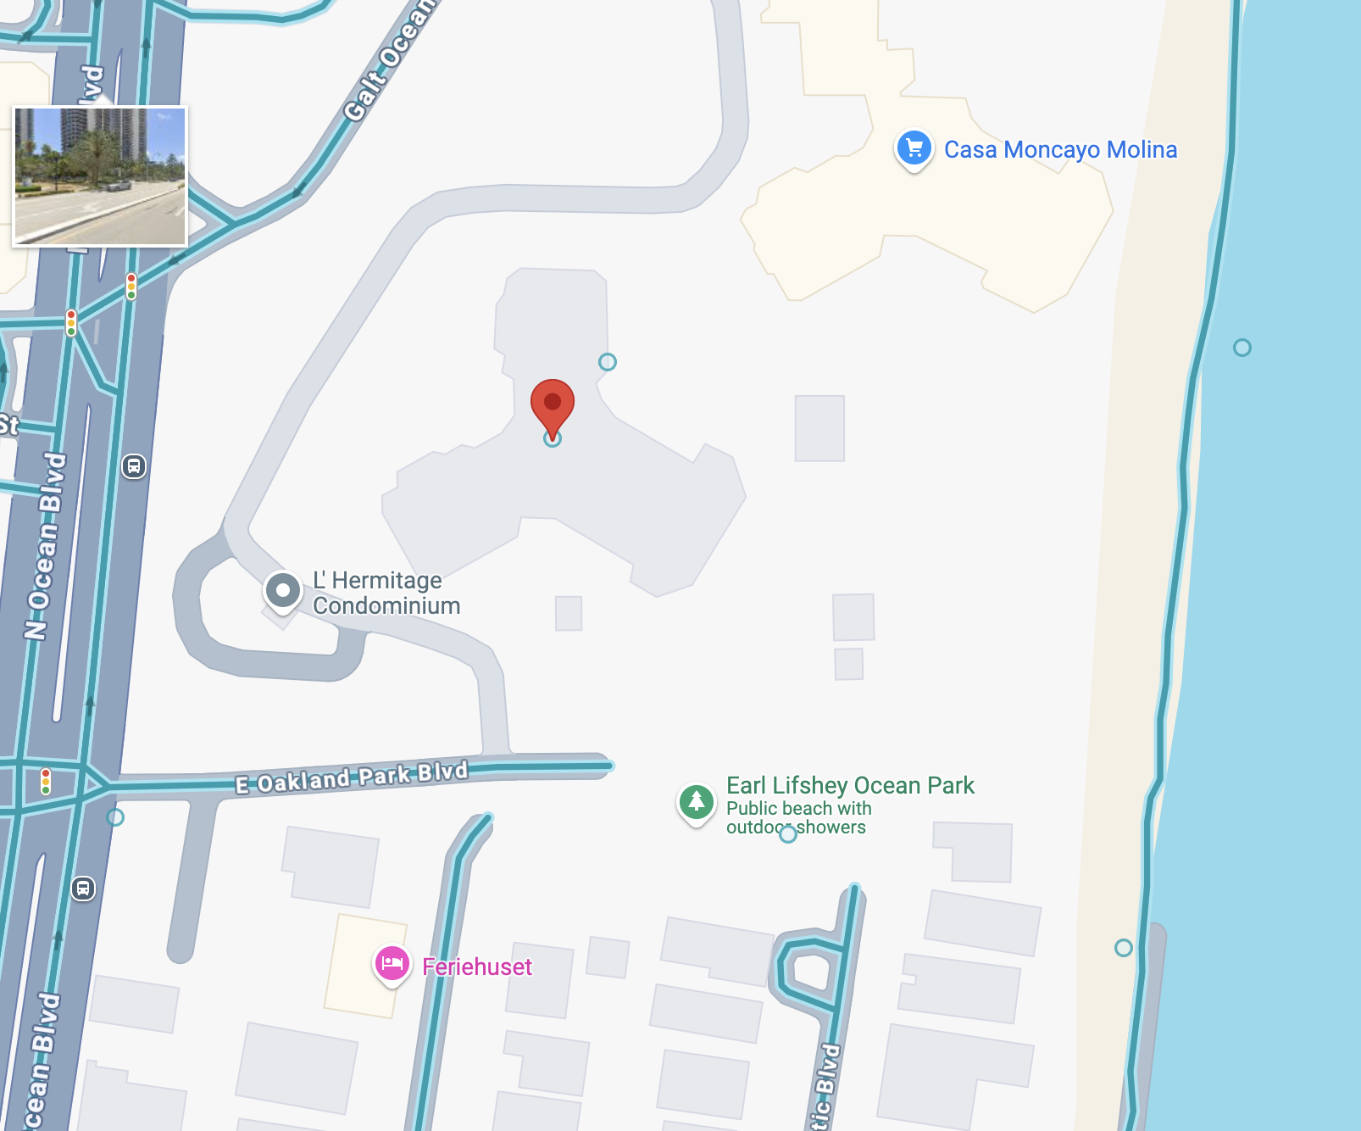
Lindeman v. CIR, 60 T.C. 609 (1973)

Slide 9
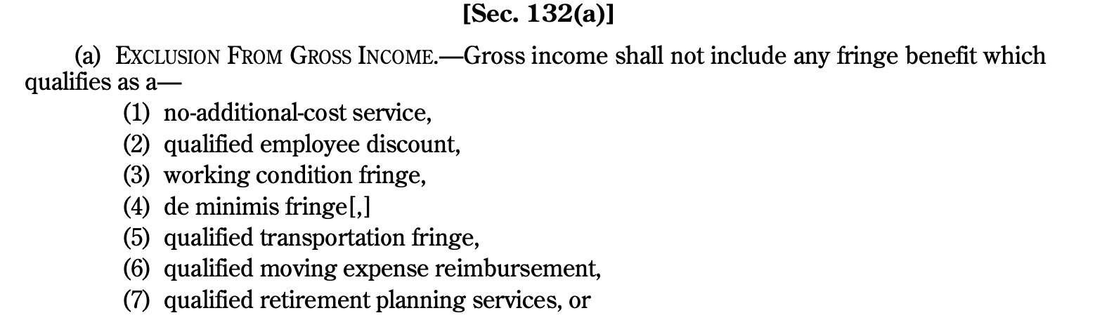
Section 132: Fringe Benefits

Slide 10
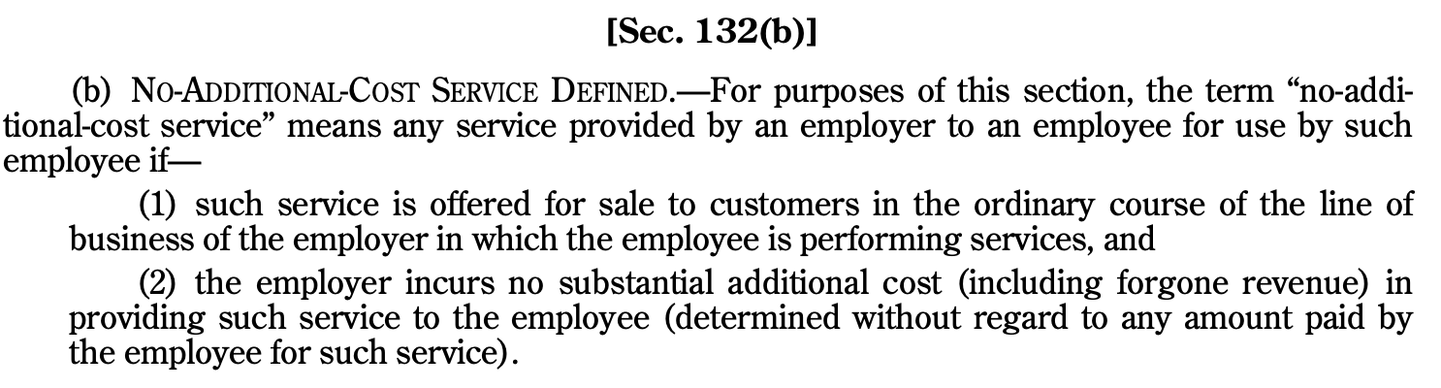
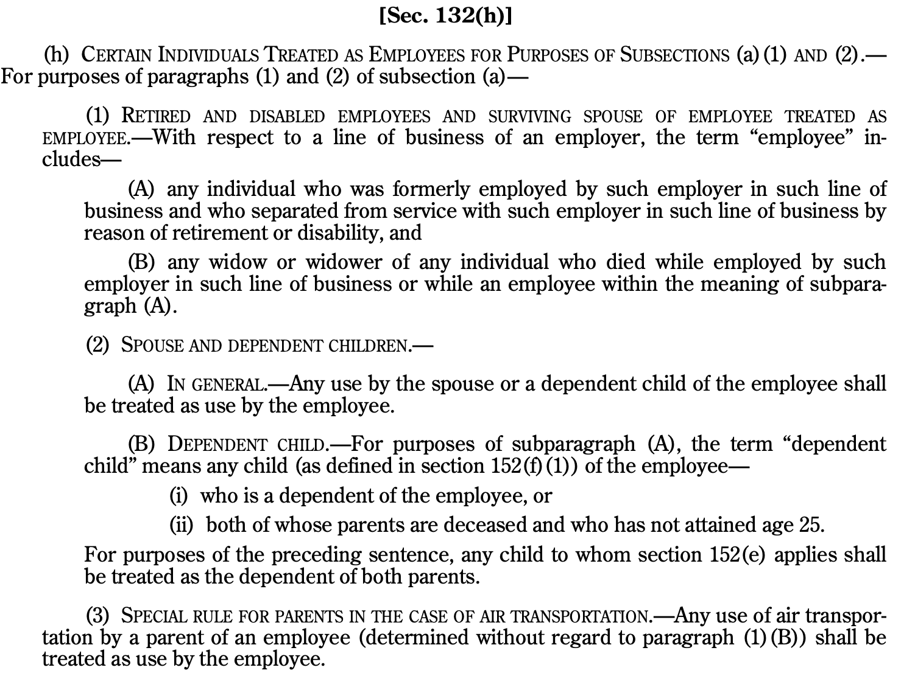
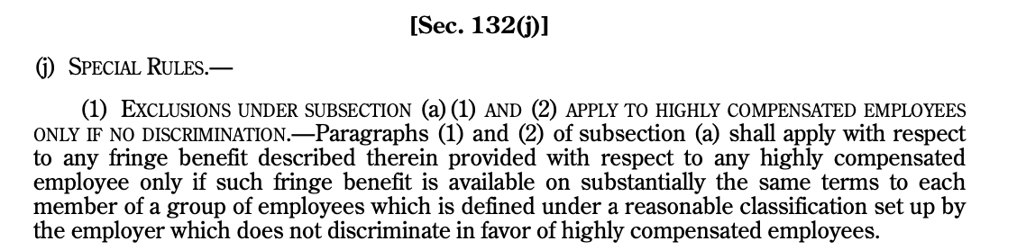
Fringe Benefits: No Additional Costs Services

Slide 11
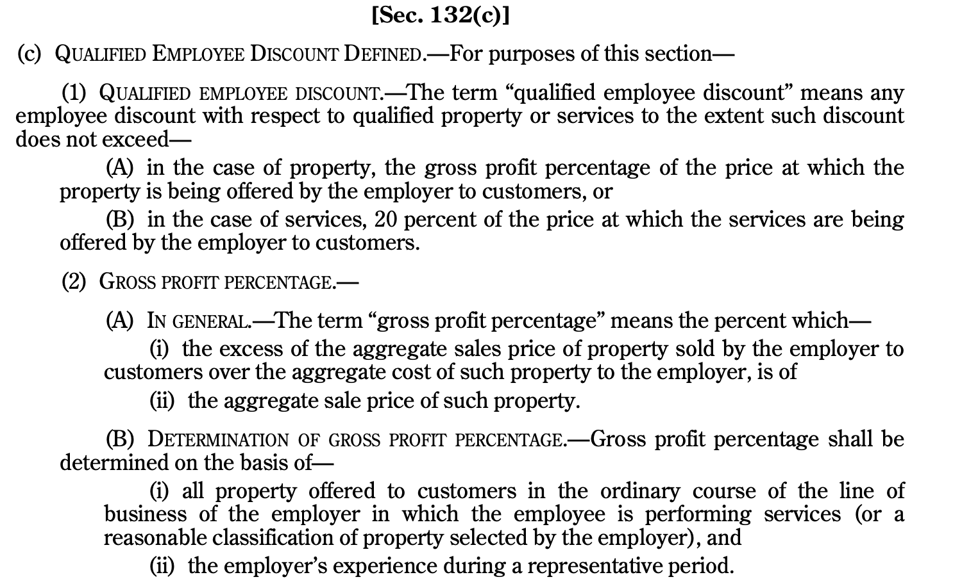
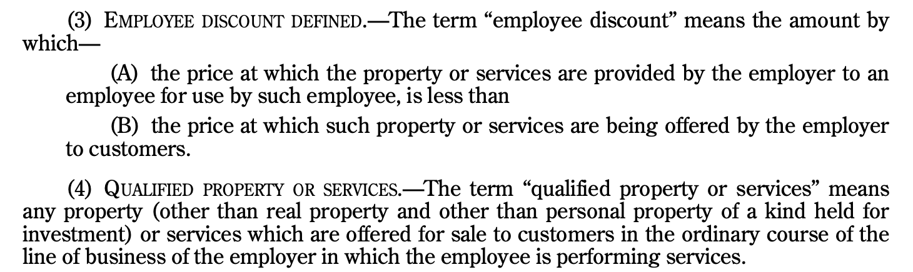
Fringe Benefits: Qualified Employee Discount

Slide 12
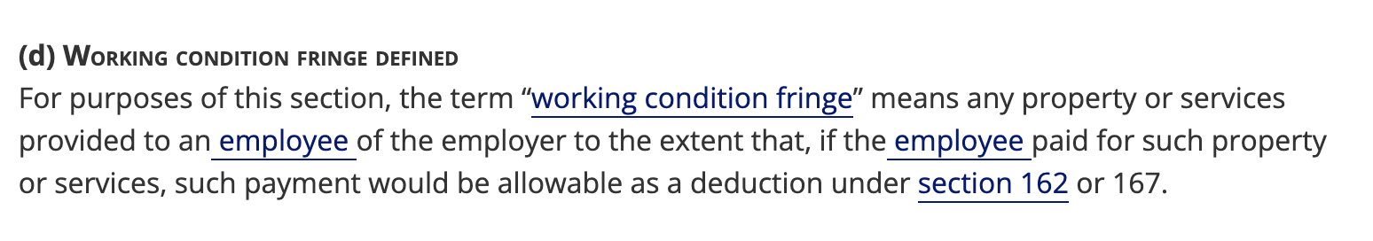
Fringe Benefits: Working Condition Fringe

Slide 13
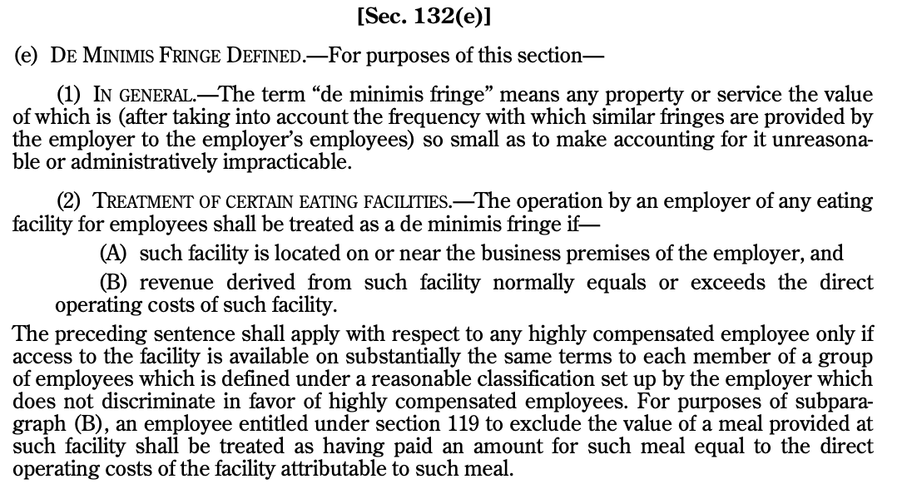
Fringe Benefits: De Minimis Fringe

Slide 14
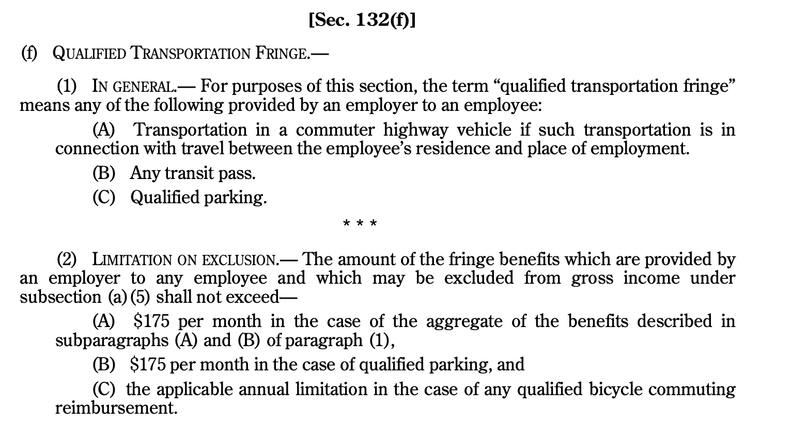
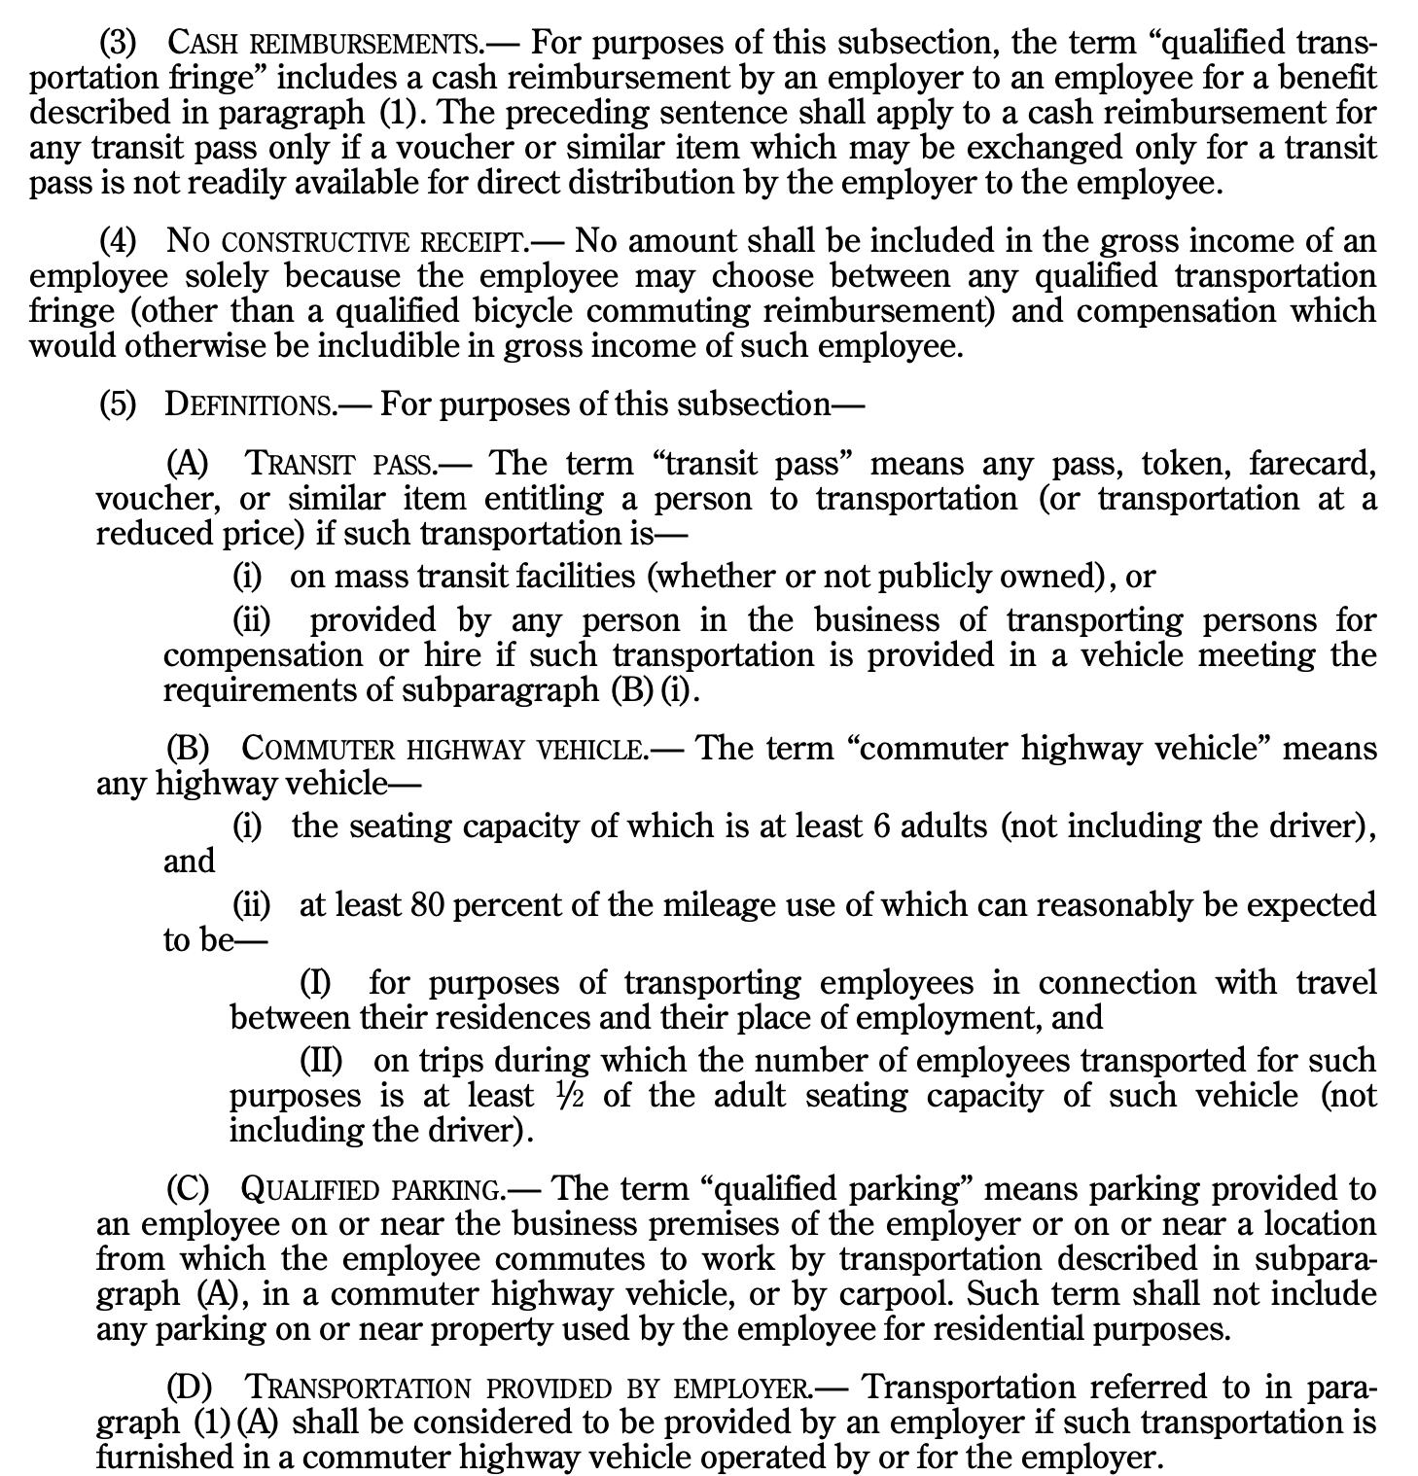
Fringe Benefits: Qualified Transportation Fringe

Slide 15
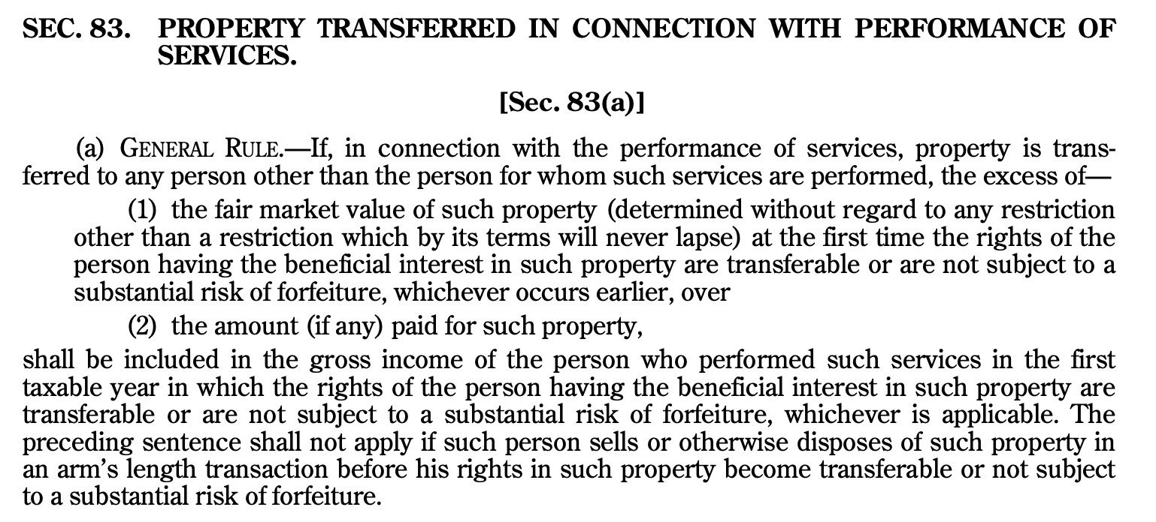
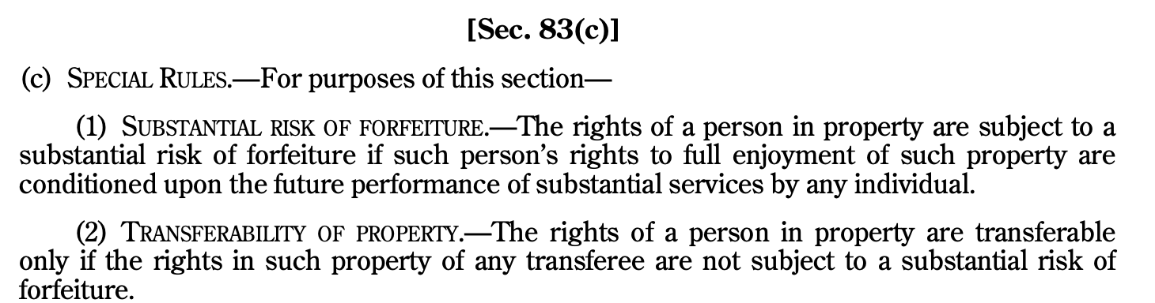
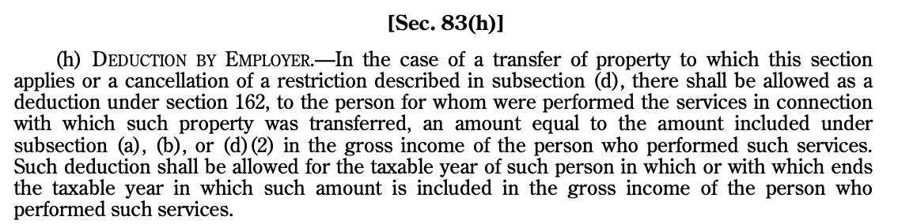
Section 83(a), (c), and (h)

Slide 16
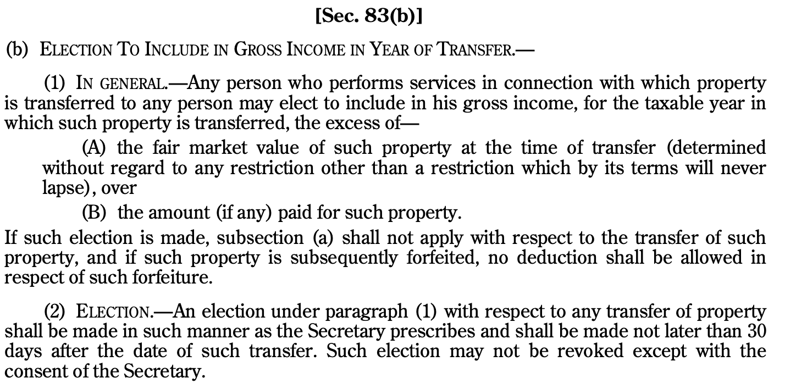
Section 83(b)

